Slide 1
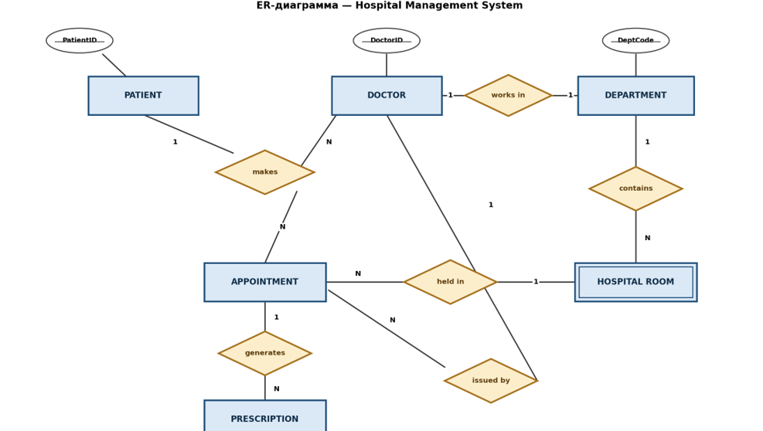
PATIENT (1) — makes — (N) APPOINTMENT: A patient can have many appointments.
DOCTOR (1) — makes — (N) APPOINTMENT: A doctor handles many appointments.
DOCTOR (N) — works in — (1) DEPARTMENT: A doctor belongs to one department (the doctor's participation is total, while the department's participation is partial).
DEPARTMENT (1) — contains — (N) HOSPITAL ROOM: An identifying relationship for a weak entity.
APPOINTMENT (N) — held in — (1) HOSPITAL ROOM: An appointment takes place in one hospital room.
APPOINTMENT (1) — generates — (N) PRESCRIPTION: Several prescriptions can be issued as a result of an appointment.
DOCTOR (1) — issued by — (N) PRESCRIPTION: A prescription is issued by one doctor.

